Slide 1
HARMFUL ALGAL BLOOM FORECASTING
aquagentic
We see algae blooms coming from space.
Tim
Demetrio
Luca
Vid
Notes:
[Presenter 1] ~10 s. “Hi, we’re Aquagentic — Vid, Demetrio, Tim and Luca. We predict harmful algae blooms before they hit, using satellites.” Then click straight to the next slide.

Slide 2
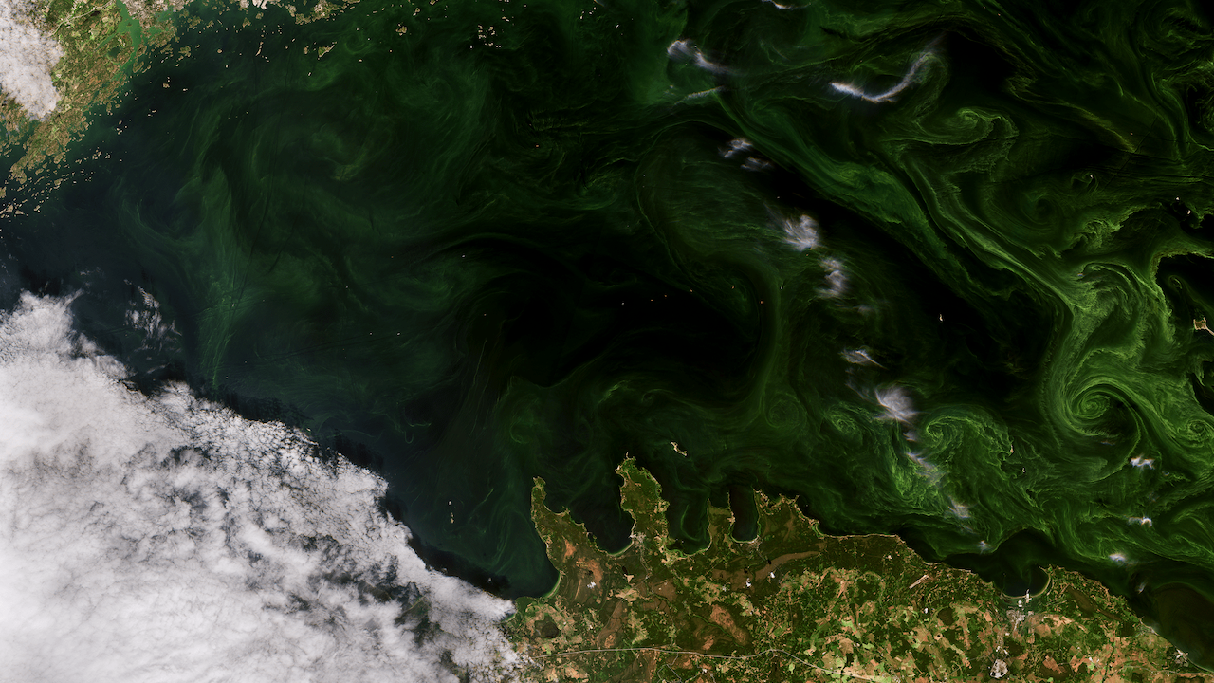
Notes:
[Presenter 1] ~10 s. Let the picture land first, then click to bring in the word. Ask the room: “Beautiful, right? Hands up if you think this could be dangerous.” Pause for the hands. “It is. And it’s happening in Icelandic waters.” To add the photo: select the picture frame and use Add image.

Slide 3
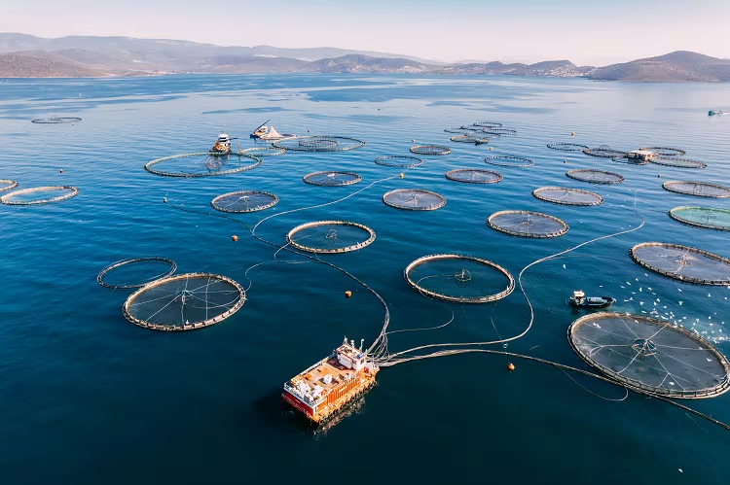
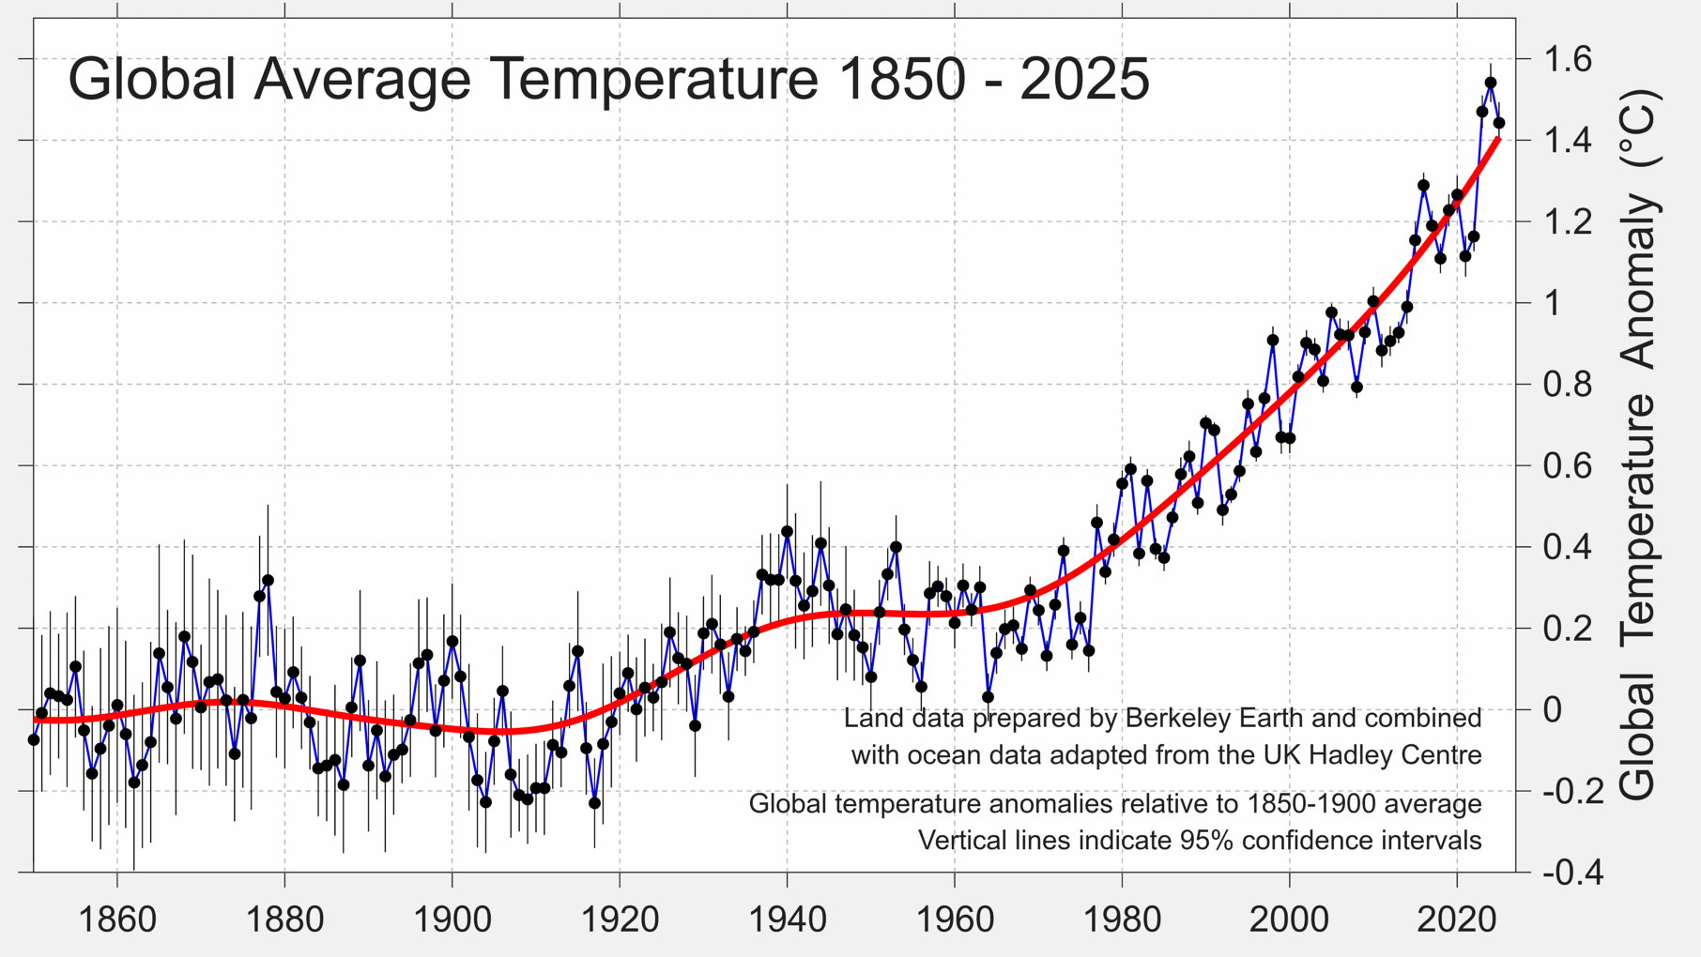
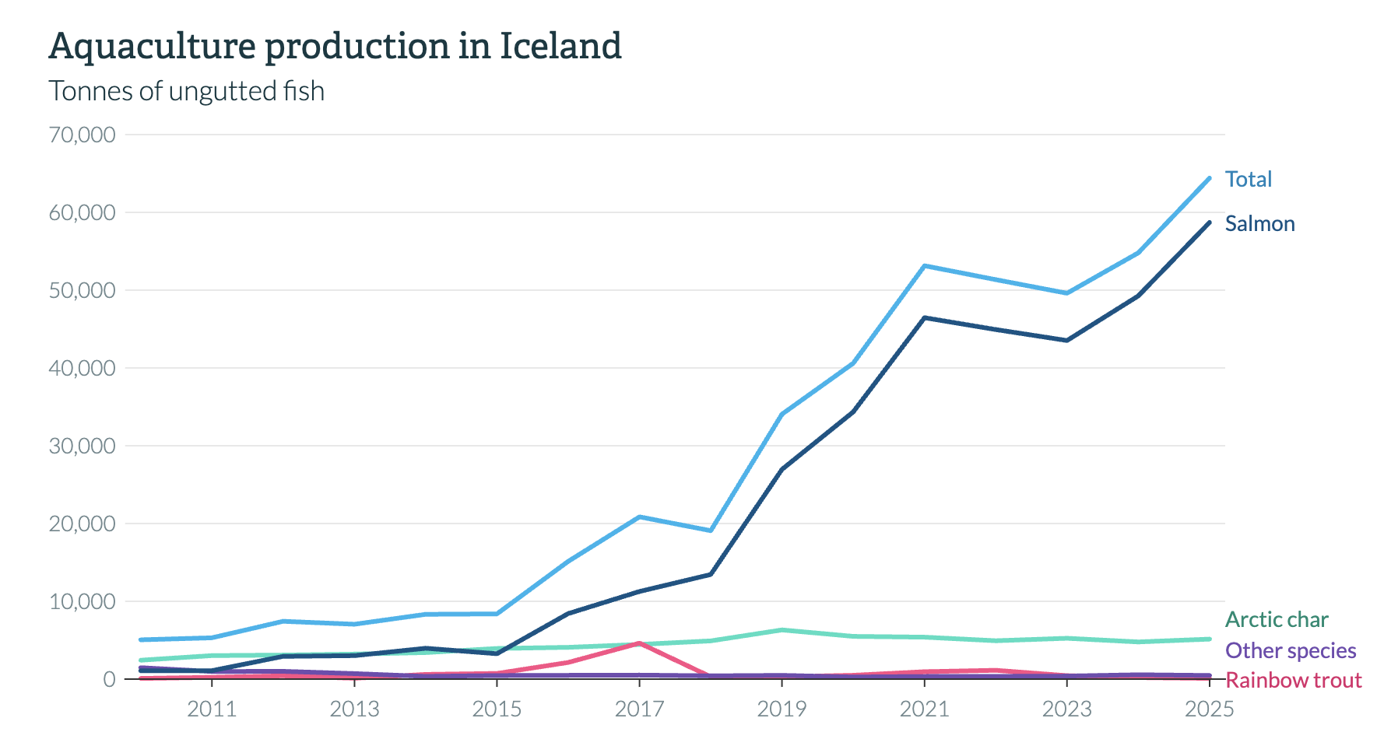
Notes:
[Presenter 1] ~25 s. Click once per card. “Harmful algae blooms suffocate fish in their pens and make shellfish toxic. In Chile in 2016 one bloom killed 27 million fish — up to 800 million dollars. In Norway in 2019, over ten thousand tonnes of salmon died in a few weeks. And here in Iceland, in June 2021, 400,000 salmon died in sea pens in a single month — Iceland’s food authority linked the deaths to algae.” Note: the 2021 Iceland deaths were suspected, not confirmed, to be algae — say “linked to” or “suspected”, not “caused by”.

Slide 4
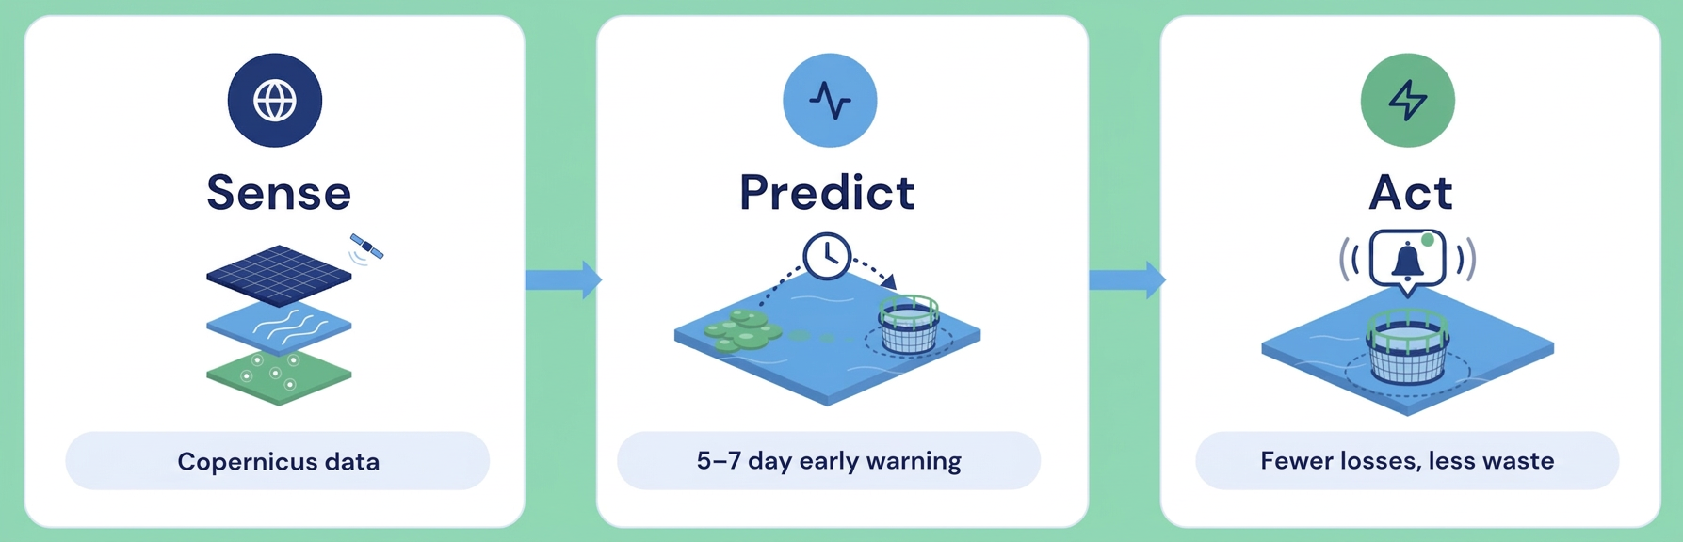
We watch every fjord from space.
Free Copernicus satellite data, turned into a bloom forecast for each farm site.
Data: Copernicus Sentinel-3 OLCI · Copernicus Marine Service · no sensors in the water
Notes:
[Presenter 2] ~30 s. Click once per step. “Our solution uses Copernicus — Europe’s free Earth-observation satellites. One: every day or so they measure ocean colour and sea temperature around Iceland. Two: when chlorophyll jumps above the normal level for that place and season, that’s a bloom. Three: we checked this against blooms that really happened — we found [__] of [__]. Four: on top of that we trained a model that predicts bloom risk [__] days ahead, for every farm.” Adjust steps 2–4 to match exactly what your pipeline does.

Slide 5
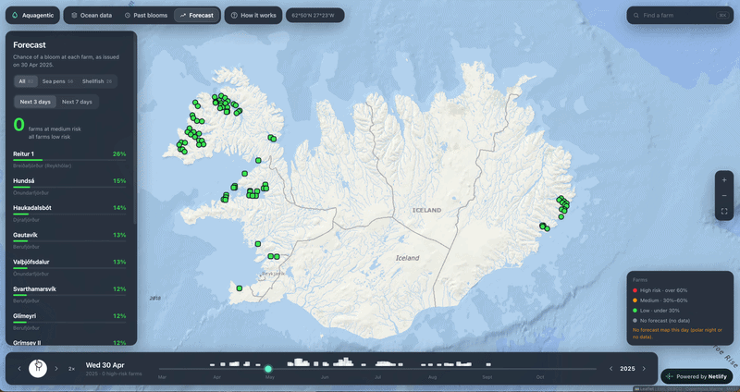
Every farm gets a live forecast.
Risk per site
Low, medium or high — at a glance, on a map.
Early warning
Alerts 3-7 days before a bloom reaches the pens.
Time to act
Stop feeding, harvest early, protect the stock.
Notes:
[Presenter 2] ~25 s. Let the GIF play. “This is our website. Every farm site gets a risk score on the map. When a bloom is coming, the farmer gets an alert [__] days ahead — enough time to stop feeding, harvest early, and save the fish.” To add the GIF: select the frame and use Add image (GIFs animate in Present mode).

Slide 6
How we make money.
$450k
$50k
$400k
actual damage per site from algae
what we charge
saved cost per site per year
Our ask
[A pilot with one Icelandic fish farm · mentors · €__ to launch]
Notes:
[Presenter 2] ~15 s. “Our business model is simple: a subscription per farm site, €[__] a month. Iceland has about [__] sea-farm sites — that’s €[__]k a year before we even leave the island. And today we’re asking for [a pilot partner / funding / mentors].” Saving even one pen from a bloom pays for years of subscription — say that line if you have a number for the value of one pen.

Slide 7
But wait…
there’s more.
Notes:
[Presenter 2] ~5 s. Apple moment — slow down. “But wait… there’s more.” Smile, pause one beat, click.

Slide 8
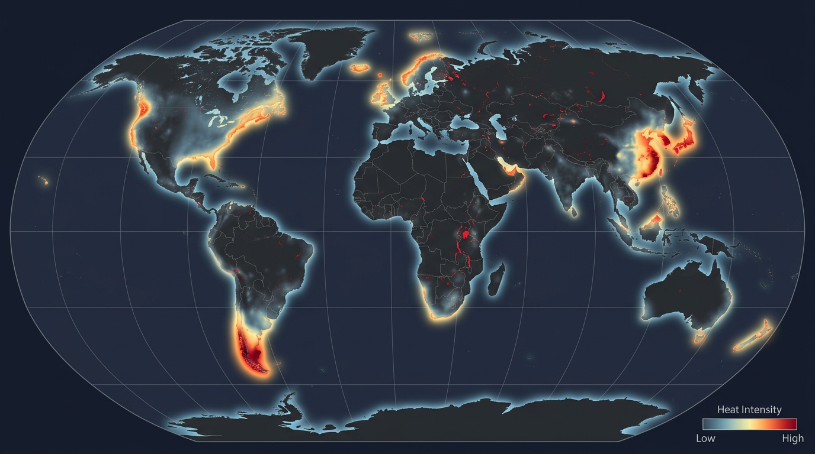
Notes:
[Presenter 2] ~15 s. “Everything you saw was Iceland. But Copernicus sees the whole planet — so adding a country is a config change, not new hardware. Norway is the world’s biggest salmon farmer. Scottish salmon is the UK’s top food export. Chile lost up to 800 million dollars in one bloom. And research institutes anywhere can use the same data.”

Slide 9
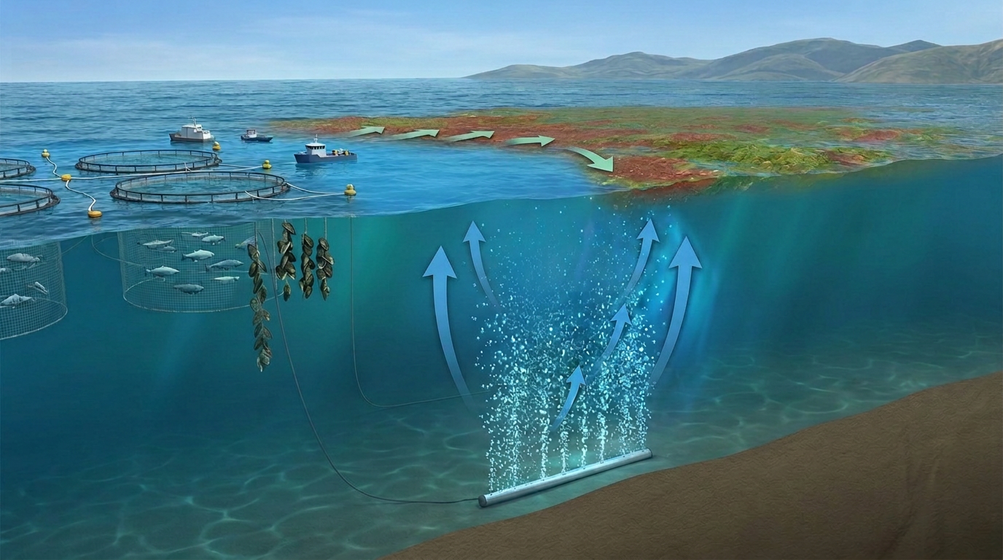

Slide 10
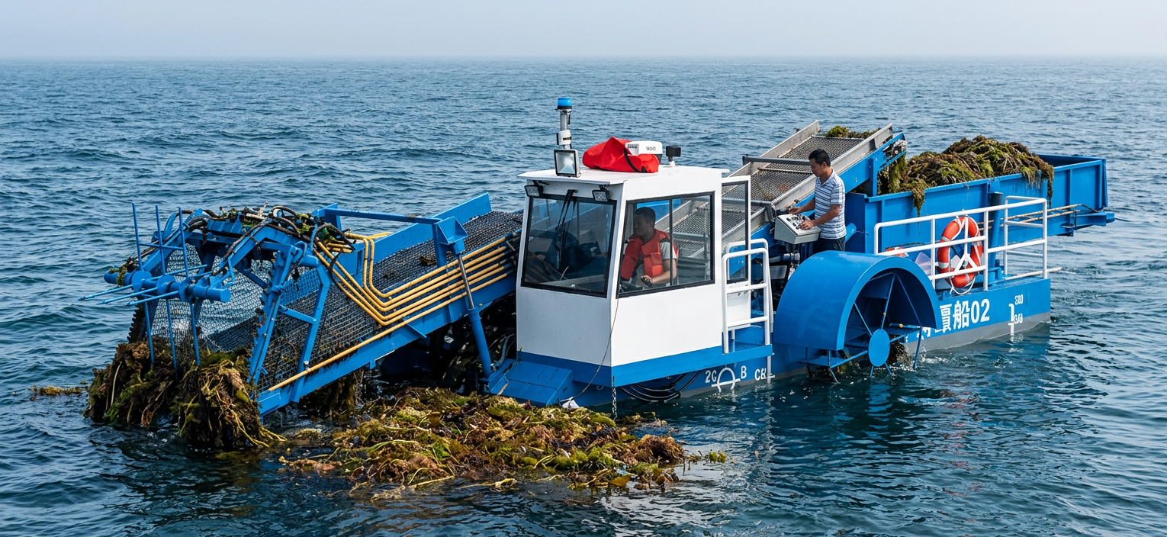

Slide 11
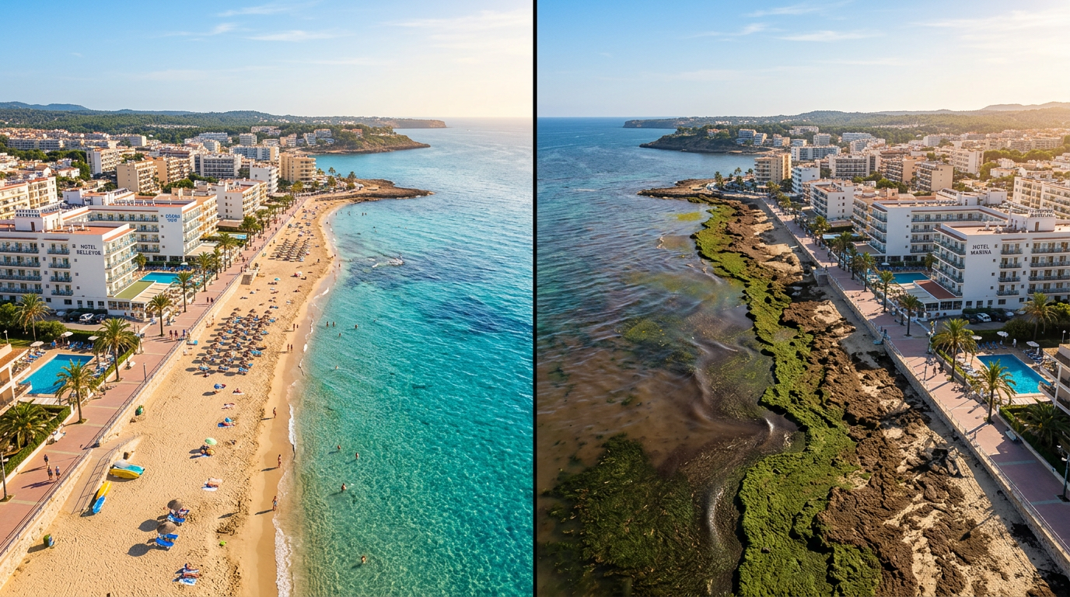
Notes:
[Presenter 2] ~15 s. “And it’s not just fish farms. Hotels and beach resorts don’t want guests arriving to green water. Insurers want to price algae risk into fish-farm policies. And desalination plants — blooms clog their intakes and can shut them down.” Pick the two you like best if you’re short on time.

Slide 12
aquagentic
See the bloom
before it hits.
Vid
Demetrio
Tim
Luca
Thank you.
Notes:
[Presenter 2] ~5 s. “Aquagentic — see the bloom before it hits. Thank you!” Both presenters step forward for questions.

